Slide 1


Modeling & Analytics presentation
Team 1

Slide 2


summary
Introduction
Our strategy
Our Portfolio
Stock information
Portfolio analysis
Assumption test
Portfolio Optimisation
Efficient frontier
Maximize Sharpe portfolio
Minimize variance portfolio
Second Strategy Weather
Takeaways
Simple Moving Average (SMA)
Keywords strategy
Montly returns
Ratio analysis
Regression analysis
Equity progression
Weight portfolio
Position
Method
Data analysis
Result

Slide 3

how can we use specific keywords on google to change the weight of the stocks in our portfolio?

Slide 4

STARBUCKS
ACTIVISION BLIZZARD
LUFTHANSA
WALMART
The ‘’Trends’’ Portfolio
Notes:
We chose 4 companies from different sectors in order to diversify our portfolio. Thus minimize risks.

Slide 5
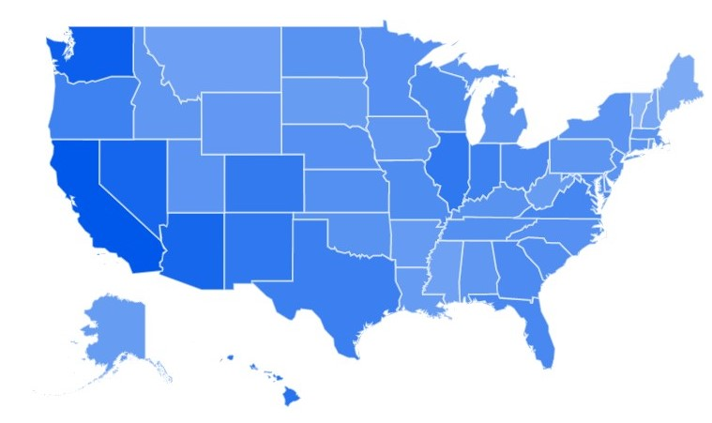
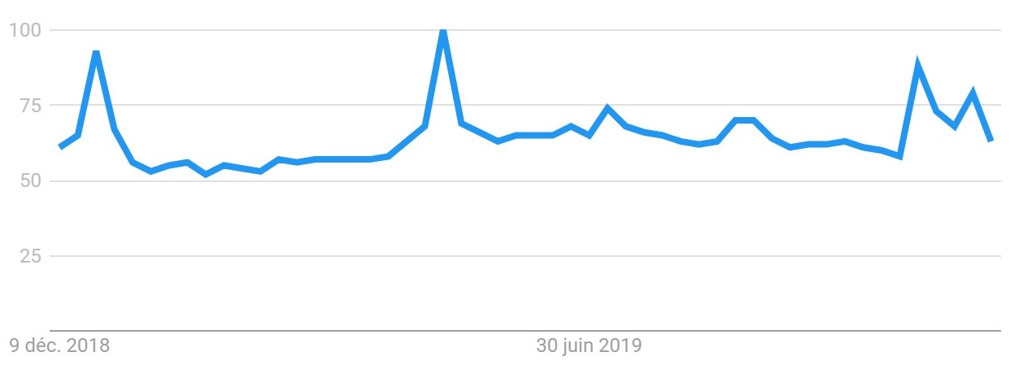

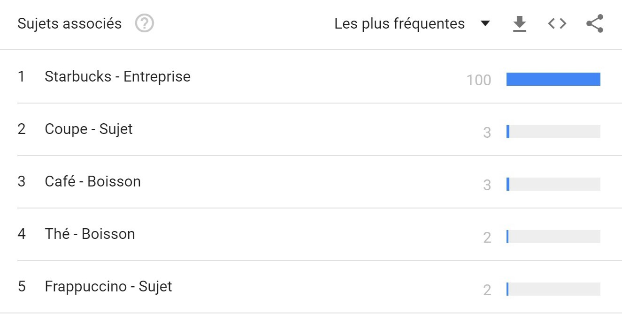
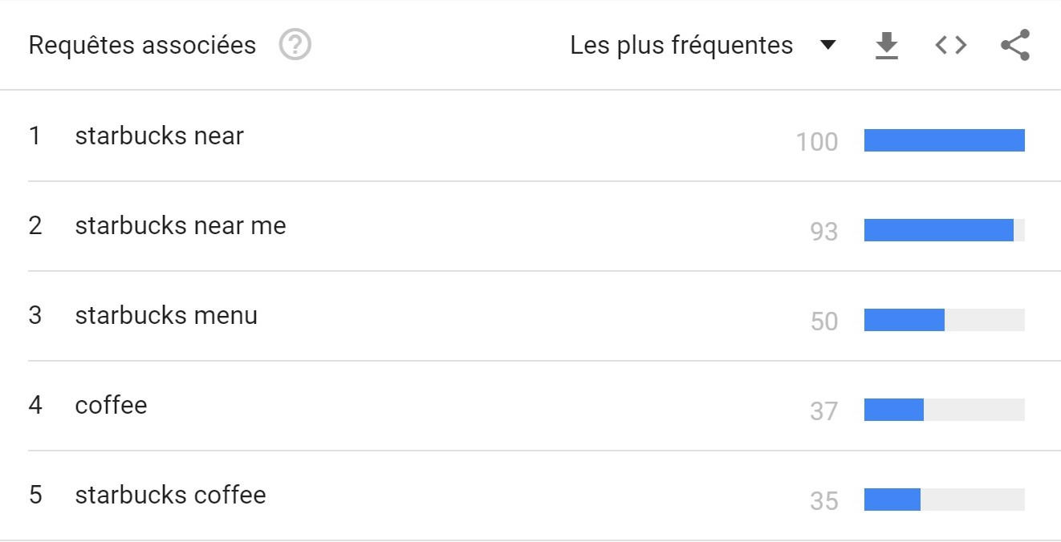
Research by regions
Research interest evolution
Associated subjects
Keywords research

Slide 6




1- ‘Starbucks near ’
2- ‘Starbucks near me’
3- ‘Starbucks menu’
1- ‘Call of duty new version’
2- ‘Call of duty black ops’
3- ‘call of duty modern warfare’
1- ‘lufthansa’
2- ‘lufthansa airlines’
3- ‘lufthansa check in’
1- ‘Walmart near me ’
2- ‘Walmart to walmart’
3- ‘Walmart pharmacy’

Slide 7
Stocks INFORMATION from 2010 - 2019
 | Total Return | Daily Sharpe Ratio | Daily Sortino | CAGR | Max Drawdown | Calmar ratio
STARBUCKS | 819,19% | 5,67 | 11,62 | 25,30% | -21,62% | 1,17
WALMART | 184,41% | 3,31 | 6,34 | 11,21% | -32,98% | 0,34
ACTIVISION BLIZZARD | 498,26% | 3,64 | 6,84 | 19,95% | -49,34% | 0,40
LUFTHANSA | 80,81% | 1,59 | 2,93 | 6,21% | -51,56% | 0,12
TOTAL PORTOLIO | 402,93% | 5,66 | 13,06 | 17,85% | -14,-62% | 1,22

Slide 8
Company monthly return (Jan 2010 – DEC 2014)
 | Starbucks | Activision Blizzard | Walmart | Lufthansa
μ | 0.015002 | 0.020695 | 0.009338 | 0.009729
σ | 0.053168 | 0.085308 | 0.052285 | 0.098013
w | 0.605777 | 0.391483 | 0.002740 | 0.000000
 | Portfolio
μ | 0.01719
σ | 0.046808
Sharp ratio | 0.367243
CORREL L - W | CORREL L - A | CORREL L - S | CORREL W - A | CORREL W - S | CORREL A – S
0.085719986 | -0.037114617 | 0.106241867 | -0.004290985 | 0.017832386 | -0.114845566

Slide 9
Regression (Monthly return keywords)
Starbucks
Walmart
Activision Blizzard
Lufthansa

Slide 10
WHY IS it IRRELEVANT ?
Notes:
The semi-strong form of market efficiency assumes that stocks adjust quickly to absorb new public information so that an investor cannot benefit over and above the market by trading on that new information. This implies that neither technical analysis nor fundamental analysis would be reliable strategies to achieve superior returns, because any information gained through fundamental analysis will already be available and thus already incorporated into current prices. Only private information unavailable to the market at large will be useful to gain an advantage in trading, and only to those who possess the information before the rest of the market does.

Slide 11
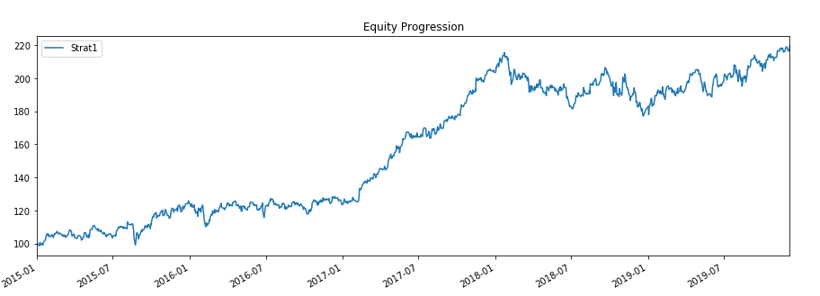
Equity Progression

Slide 12
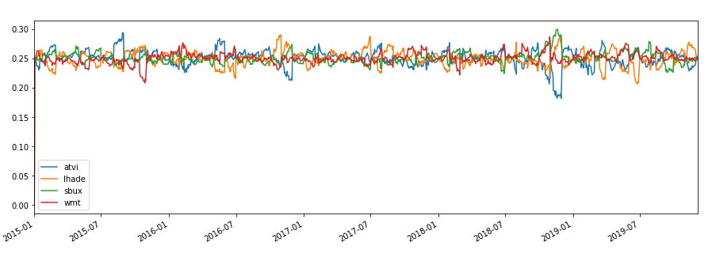
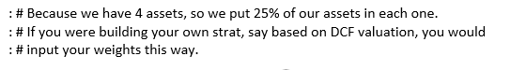
W Portfolio

Slide 13
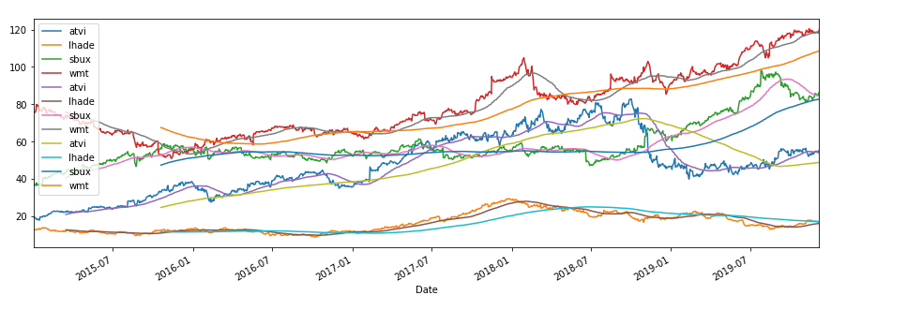
Moving Average 50 and 200 day Graph

Slide 14
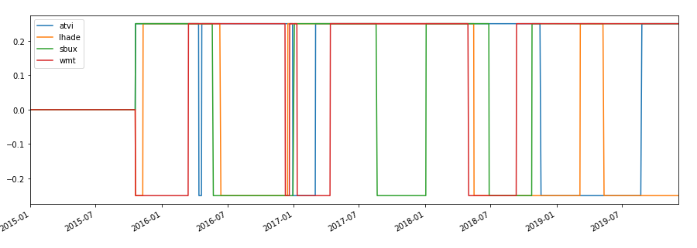
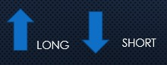
POSITIONS

Slide 15

INVESTMENT PORTFOLIO OPTIMISATION WITH PYTHON

Slide 16
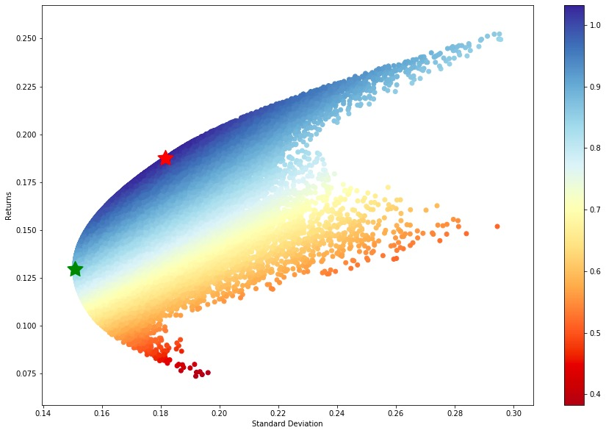
Efficient Frontier

Slide 17
Maximize Sharpe Portfolio
Index | Ret | Stdev | Sharpe | ATVI | LHA.DE | SBUX | WMT
50303 | 0.187347 | 0.181548 | 1.03194 | 0.366774 | 0.190914 | 0.400752 | 0.0415607

Slide 18
Minimize Variance Portfolio
Index | Ret | Stdev | Sharpe | ATVI | LHA.DE | SBUX | WMT
40797 | 0.129459 | 0.150759 | 0.858714 | 0.114502 | 0.173145 | 0.316914 | 0.395439

Slide 19
keywords in python
METHOD
DATA
ANALYSIS
RESULT
CONCLUSION

Slide 20
data
﻿Start from 2011-01-01 and End at 2019-11-30
Come up our strategy with data from 2010-01-01 to 2014-12-31
(To determine the signal to change the weight of our portfolio, M)
Test our strategy with data from 2015-01-01 to 2019-11-30
Get the data of return using BT.

Slide 21
Method
﻿Using loop to find the best signal (M) to change the weight of our portfolio which gives the best return between 2010-01-01 to 2014-12-31.
Use M to test our strategy from 2015-01-01 to 2019-11-30 to find the outcomes of our portfolio.
Compare the outcome with other strategies to see how is our performance.

Slide 22
k = 0
J=0
﻿for i in range(1,58):
if data_keywords['sbux'][j] - data_keywords['atvi'][k] > m:
target_weights['sbux'][i]= 0.01+target_weights['sbux'][i-1]
target_weights['atvi'][i]= 1- target_weights['sbux'][i]
if data_keywords['sbux'][j] - data_keywords['atvi'][k] < -m:
target_weights['sbux'][i]= -0.01+target_weights['sbux'][i-1]
target_weights['atvi'][i]= 1- target_weights['sbux'][i]
else:
target_weights['sbux'][i] = target_weights['sbux'][i-1]
target_weights['atvi'][i] = target_weights['atvi'][i-1]
k=k+1
j=j+1

Slide 23
result of keywords
 | Total Return | Daily Sharpe Ratio | Daily Sortino | CAGR | Max Drawdown | Calmar ratio
No Strategy | ﻿162.78% | ﻿ 5.90 | ﻿14.04 | ﻿22.13% | -17.57% | ﻿1.26
Optimized | 169.09% | 5.44 | 11.42 | 22.73% | -25.41% | 0.89
Keywords (m=0.05) | 155.11% | 4.62 | 8.24 | 21.78% | -36.67% | 0.59
Keywords (m=0.77) | 171.11% | 5.48 | 11.37 | 23.35% | -26.10% | 0.89

Slide 24
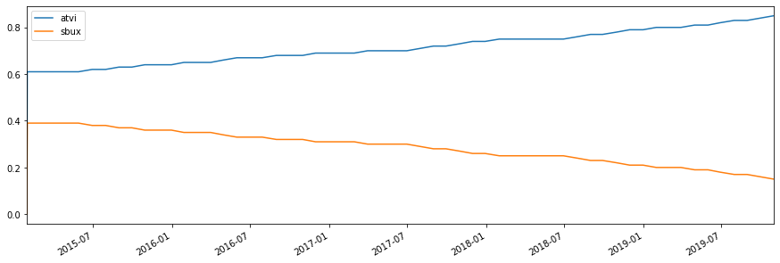
Result: weight when m=0.05

Slide 25
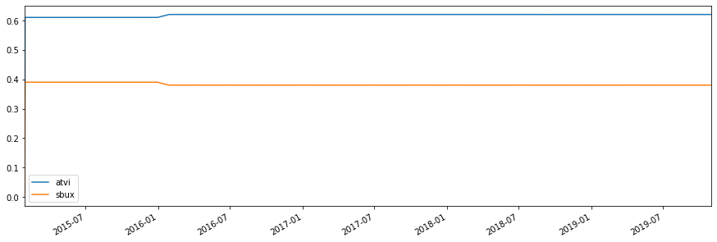
Result: weight when m=0.77

Slide 26
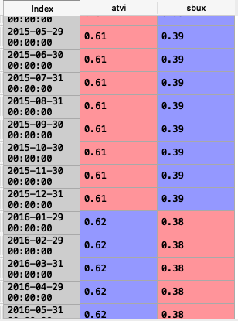
Result: Target weight
Only changed one time during the last 5 years!

Slide 27
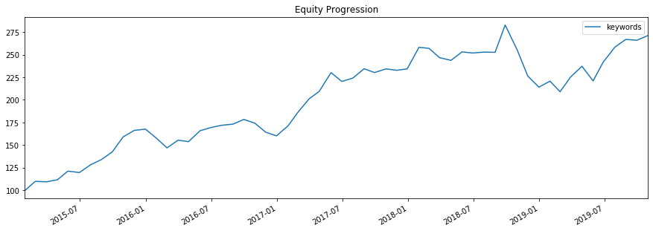
Result: Equity progression

Slide 28
Analysis
﻿Keywords somehow gives us a better return of our portfolio.
But M does not look super good because target weights only changed one time during the last 5 years.
This value may be meaningful for this portfolio, so more testing may be needed.
May be useful for our current portfolio, but for other portfolios we will have a separate M, which may not be useful

Slide 29
Conclusion of keywords
Not so cool But it is worthy of reference
it has certain reference value

Slide 30


second strategy: weather case

Slide 31

second strategy: weather case
Weather
Starbucks Returns

Slide 32
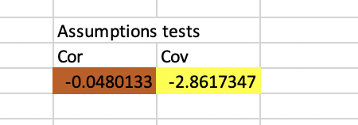
Assumptions Tests

Slide 33
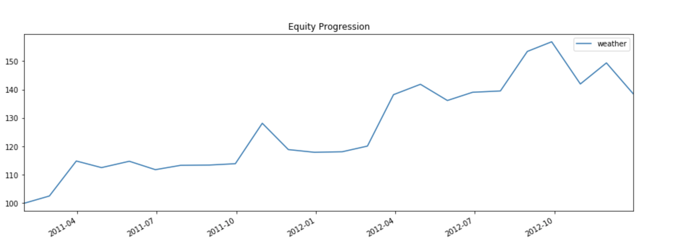
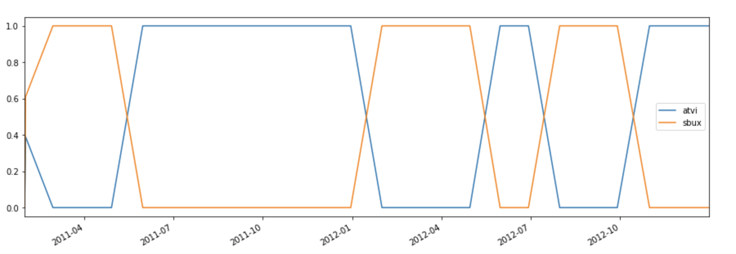
BACKTESTING RESULTS

Slide 34
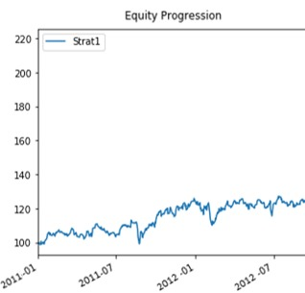

Slide 35
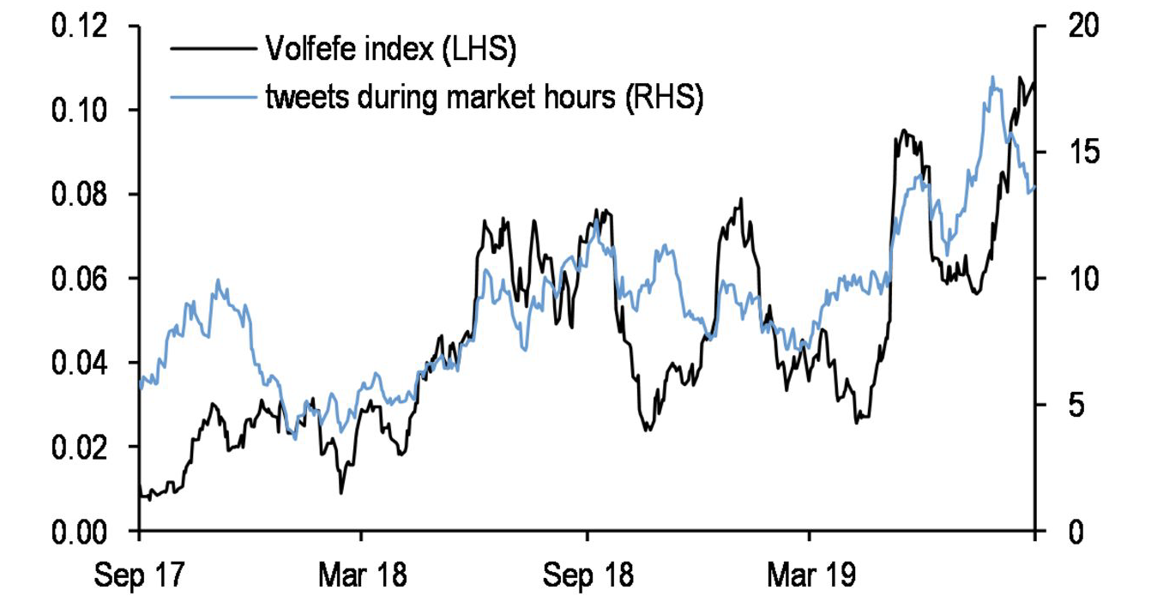
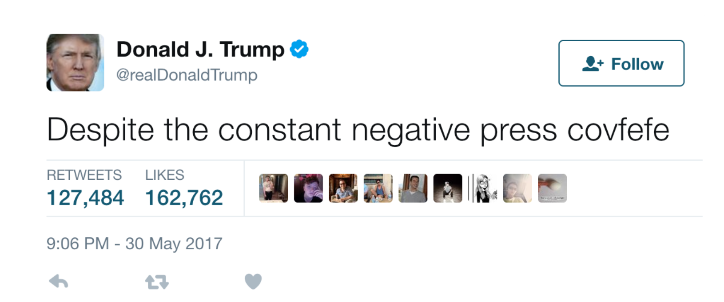
THE VOLFEFE InDEX

Slide 36
TAKEAWAYS
TRENDS CAN BE USEFUL
FINDING THE RIGHT TREND IS CHALLENGING
DIVERSIFIED INDUSTRY DOES NOT MEAN ‘’DIVERSIFICATION’’
TRENDS STRATEGY CAN BE VERY VOLATILE
SURVIVORSHIP BIAS CAN PROVE US WRONG

Slide 37

Thank you

